Slide 1
Network Theory
BY
Uddhav Bhattarai, Assistant Professor
Cosmos College of Management and Technology

Slide 2
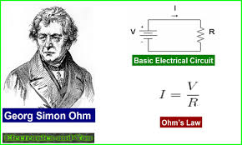
Revision
Ohm’s Law

Slide 3
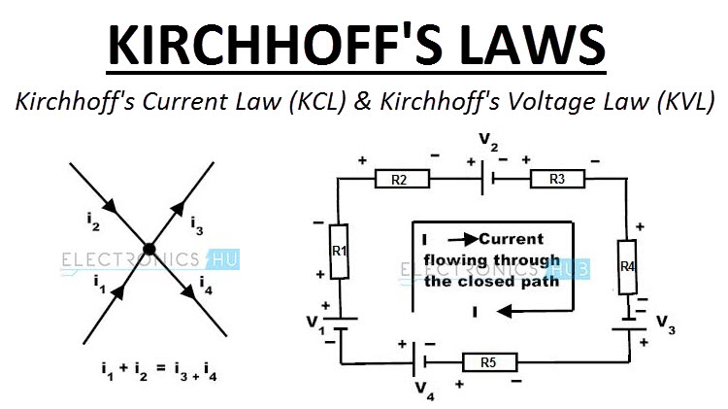
KCL and KVL

Slide 4
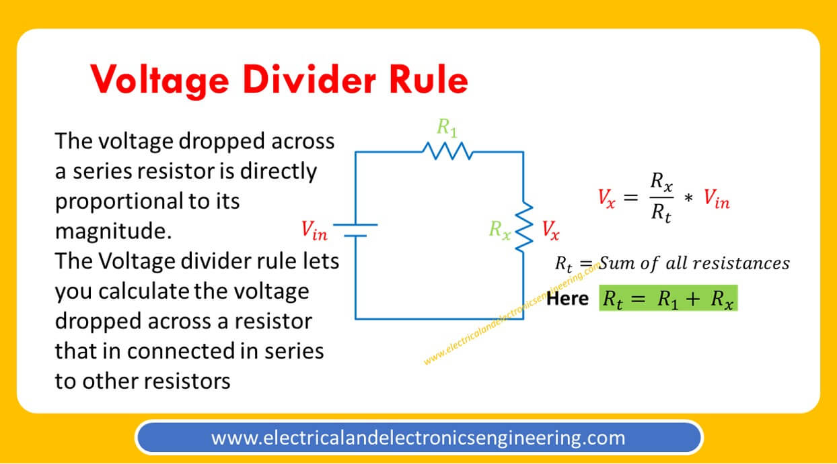
Voltage Divider Rule

Slide 5
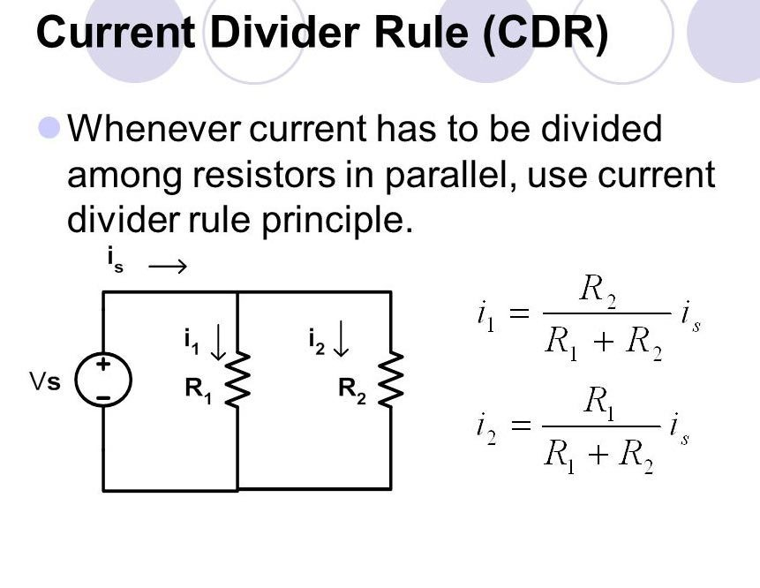
Current Divider Rule

Slide 6
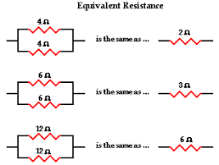
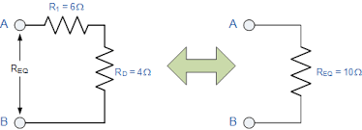
Equivalent Resistance

Slide 7
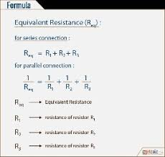
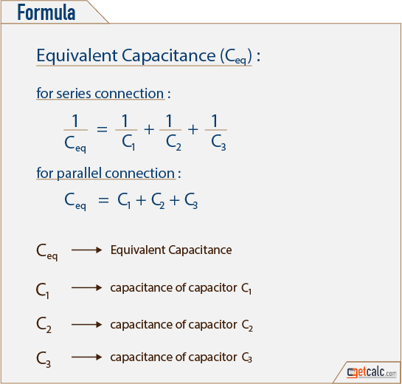
Equivalent Capacitance and Resistance

Slide 8
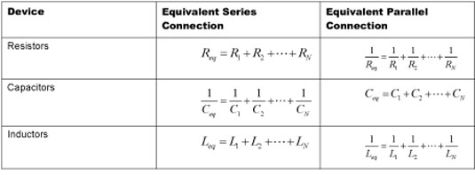
Equivalents

Slide 9
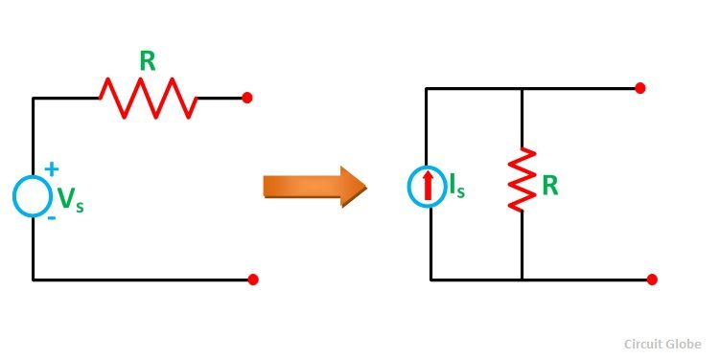
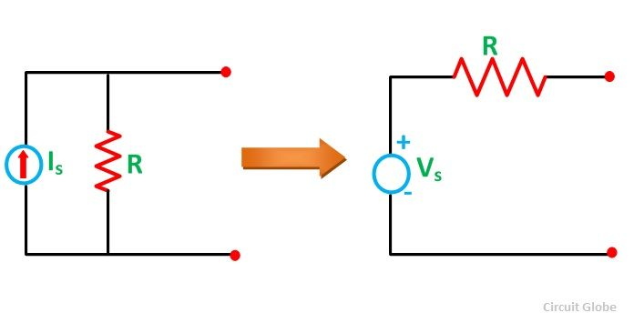
Source Conversion

Slide 10
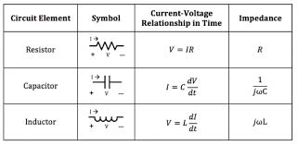
Voltage-Current Relationships

Slide 11

Next: Nodal And Mesh Analysis

